Slide 1
988 Florida Lifeline
An Early Crisis Intervention
Erica Floyd Thomas, MSW
Assistant Secretary for Substance Abuse and Mental Health
Department of Children and Families
October 25th 2024

Slide 2

Crisis Continuum of Care
988 Florida Lifeline
“Someone to Talk to”
Mobile Response
“Someone to Respond”
Crisis Stabilization
“Somewhere to Go”
Connections to Care Coordination and other Community Behavioral Health Services

Slide 3

What is the 988 Florida Lifeline?
The 988 Florida Lifeline is a network of accredited, Florida-based 988 call centers familiar with local behavioral health providers and community resources.
This network of 988 centers are staffed by local crisis counselors available 24 hours a day, seven days a week.

Slide 4

Someone to Talk To
There are many reasons someone may find themselves needing someone to talk to. Some of these include:
Grieving the loss of a loved one.
Feeling overwhelmed.
Feeling depressed or having thoughts of suicide.
Mental illness or emotional trauma.
Stressful life events.
Economic worries.
Substance use.
You do not have to wait until emotional concerns turn into a suicidal crisis to call.

Slide 5
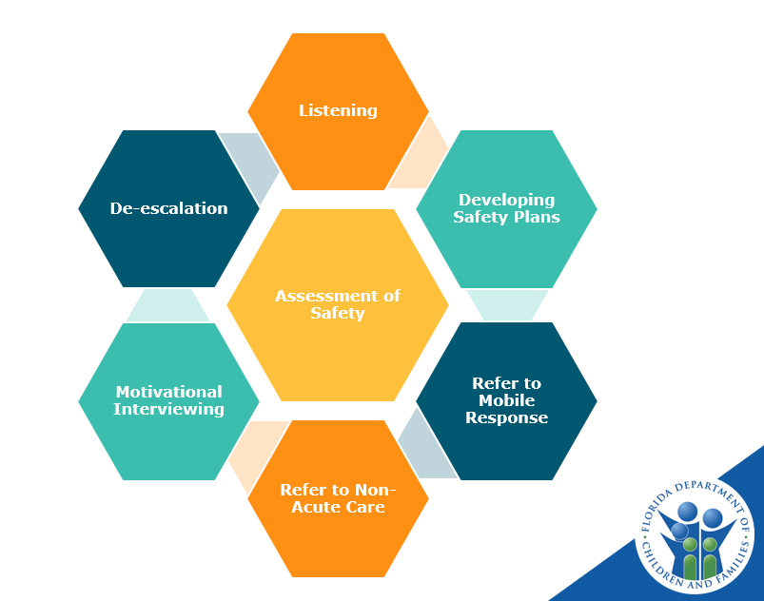
Crisis Counseling
Following an automated voice prompt, a call is routed to the appropriate 988 center.
When a 988-crisis counselor answers a call, their first step is assessing the caller’s safety.
Once the caller’s safety has been assessed, the counselor employs a variety of strategies to assist the caller in the manner appropriate to the individual’s situation.

Slide 6
Acute vs Non-acute Crisis
Acute Crisis – Suicide in Progress
Acute Crisis – No Suicide in Progress
Non-Acute Crisis
When a caller presents as an active suicide in progress, the crisis counselor will request immediate emergency dispatch through 911.
When a caller presents with an acute crisis that is not an active suicide in progress, the counselor will work to de-escalate the individual. If the counselor determines the caller needs an in-person response, they will refer the caller to the local Mobile Response Team (MRT).
When a caller presents with a non-acute crisis or can be de-escalated over the phone, the counselor will work with the caller to develop safety plans, assist with coping strategies, and conduct motivational interviewing. If the counselor determines the caller would benefit from continued non-acute behavioral health services, they can refer the caller to the appropriate provider within their local community.
With caller consent, counselors can also schedule and perform follow-up wellness check-in calls.

Slide 7
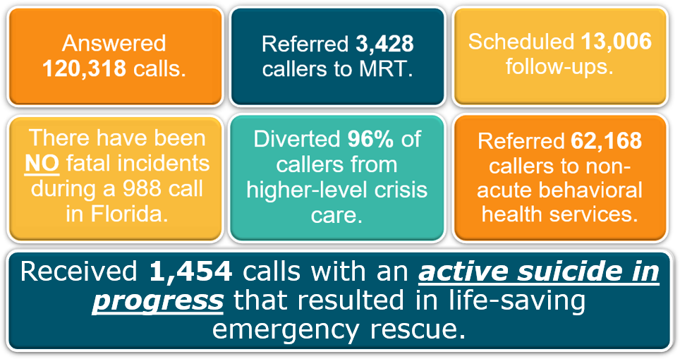
988 Florida Lifeline Data
In SFY 2023-24, the 988 Florida Lifeline:
Data Sources: Vibrant Monthly Call Metrics Report and DCF 988 Contractual Monthly Center Reporting

Slide 8
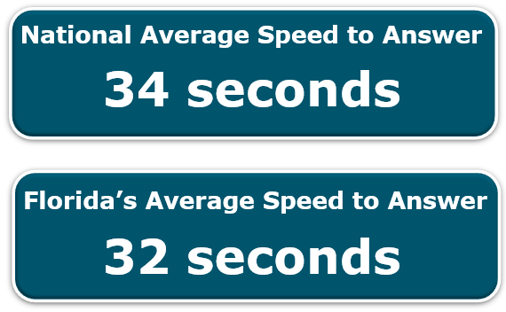
National Comparisons
Average Speed to Answer
Average Talk Time
Data Source: Vibrant Monthly Call Metrics Report (August 2024)

Slide 9

Reasons for Calling
About 40% of calls have some degree of suicidal thoughts or feelings, but only around 2% of calls are an active suicide risk.
Just over 7% of calls are primarily a substance use crisis.
Roughly 50% of calls are for non-suicidal mental health concerns.
47,763
# of callers who contacted the Veterans Line.
Data Sources: Vibrant Monthly Call Metrics Report and DCF 988 Contractual Monthly Center Reporting
Notes:
The reasons people call can sometimes be complex and don’t always fall neatly into a category. Our data collection is still evolving to better capture this complexity. However, of the calls that can currently be broadly categorized, we know that about 40% have some degree of suicidal thoughts or feelings, but only around 2% of calls are an active suicide risk.
Individuals with a substance use crisis are also calling. A little over 7% of calls are primarily substance use crises.
Overall, nearly 50% of calls are for non-suicidal mental health concerns.
We also know that 47,763 calls from Florida to 988 were from Veterans who chose to press 1 for the 988 Veterans Line.

Slide 10

988 in Escambia & Santa Rosa Counties
211 UWWF
Primary Counties:
Bay, Calhoun, Escambia, Gulf, Holmes, Jackson, Okaloosa, Santa Rosa, Walton, Washington
211 Big Bend Primary Counties:
Franklin, Gadsden, Jefferson, Leon, Liberty, Madison, Taylor, Wakulla
Who answers calls for Escambia and Santa Rosa Counties?
Primary Call Center:
In-State Backup Call Center:
211 Big Bend
211 United Way of West Florida

Slide 11
Northwest Florida 988 Metrics – Fiscal Year 2023-2024
Answer Rate
73%
Calls Answered
2,862
211 Big Bend
Average Speed to Answer
26 Seconds
Diversion Rate
99%
Answer Rate
98%
Calls Answered
8,785
211 United Way of West Florida
Average Speed to Answer
2 Seconds
Diversion Rate
87%

Slide 12
Northwest Florida 988 Metrics – July 2024 to September 2024
Answer Rate
82%
Calls Answered
689
211 Big Bend
Average Speed to Answer
25 Seconds
Diversion Rate
99%
Answer Rate
99%
Calls Answered
2,866
211 United Way of West Florida
Average Speed to Answer
2 Seconds
Diversion Rate
89%

Slide 13


Suicide is preventable.
The 988 Florida Lifeline is here to listen day or night.
Because every life has a story.
And…

